Slide 1
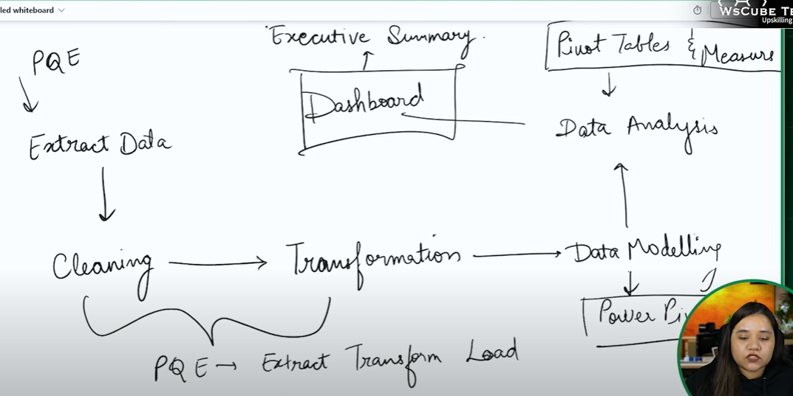
Power Pivot
PQE- Power Query Editor

Slide 2
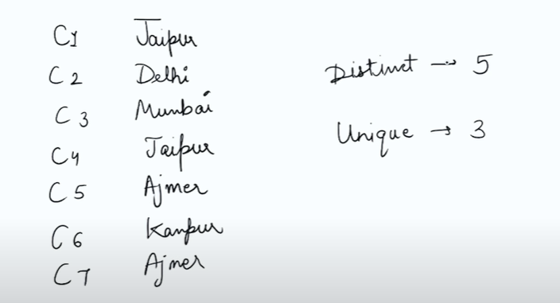
Go to data tab
Get data --- from folder --- select folder
After loading data set transform it
Right click on binary--- add as new query and rename as customers similarly for the Orders and Products
Jaipur, Delhi, Mumbai, Ajmer, Kanpur
Delhi, Mumbai, Kanpur

Slide 3
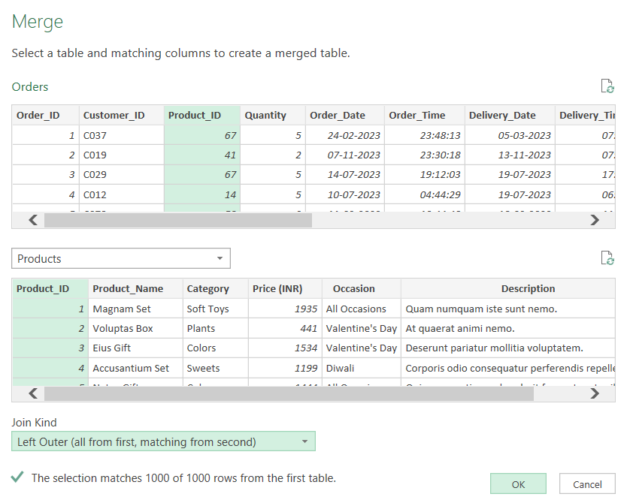
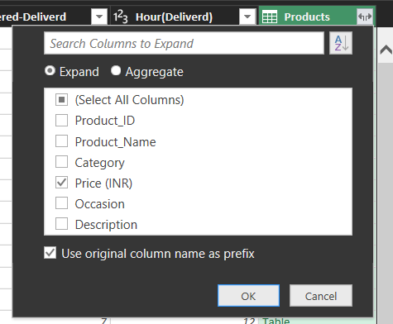
Order table--- go to order date column--- date—month---name of the month
Order time--- time ---hour---Hour(Ordered)
Delivery time---time---hour—Hour(Delivery)
Add column --- difference in days after ordering to delivery--- duration--- days
After joining two tables by product id---expand and select price

Slide 4
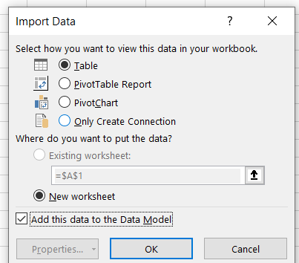
After all transformation --- close & load to
Hide sheet(FNp dataset)

Slide 5
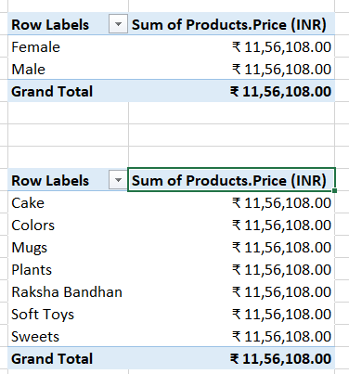
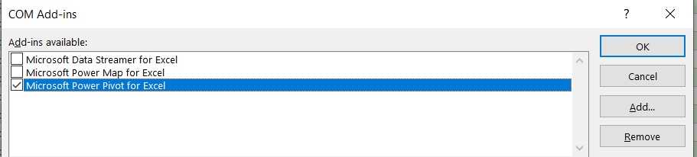
After loading data --- go to insert and add gender to rows and price to values but the values which we are getting are same to same because of sheets (Product id, customer id)are not connected to each other
Import developer tab from options--- go to COM Add ins

Slide 6
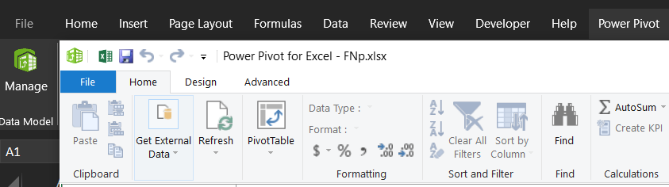
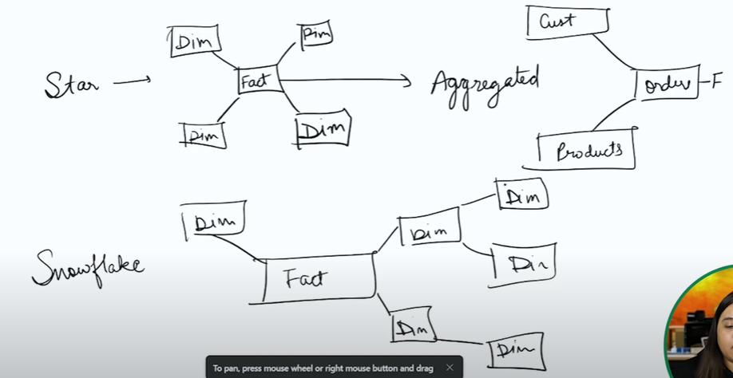
After adding power pivot --- go to manage ---- you will land into new window as power pivot for excel to get connection between table
Star Schema: A star schema organizes data into a central fact table connected to dimension tables in a straightforward, star-like pattern. It's simple, optimized for queries, and ideal for reporting and analysis in Power Pivot.
Snowflake Schema: A snowflake schema normalizes dimension tables, breaking them into multiple related tables. This reduces redundancy but increases complexity. It's less efficient for querying compared to the star schema but saves storage space.

Slide 7
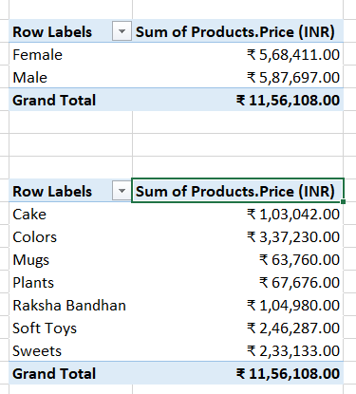
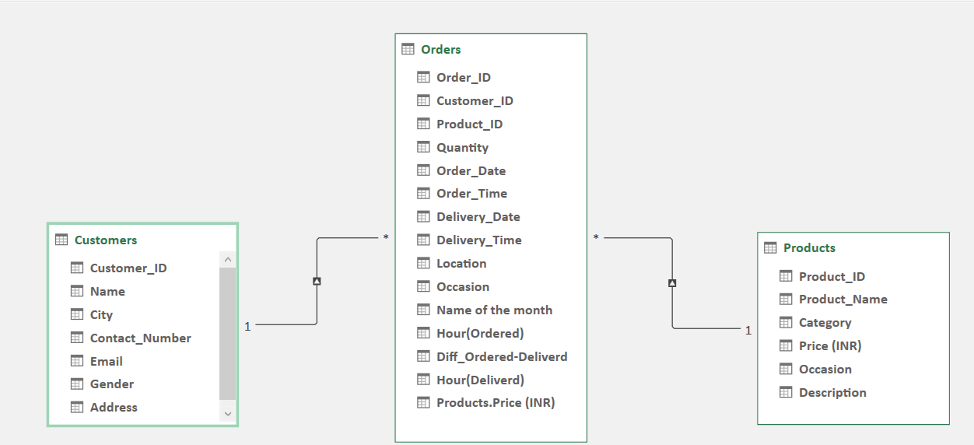

In power pivot page --- go to Diagram view and connect the order ID and Product ID , they can make 1 to many relationship with other table and after connecting tables you will get the correct result of gender and price as shown in previous slide and getting correct values

Slide 8
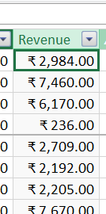
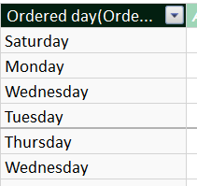
After that in power pivot---go to Data view ---- in orders--- add column---named as Revenue = price * Quantity --- revenue column generated like this
After adding revenue column now create another column named as orderd day which was fetched from the column order date by using DAX –FORMAT function --- will fetch days on which date orederd
=FORMAT(Orders[Delivery_Date],"DDDD")

Slide 9
Creating dashboards

